Slide 1
DFT and FFT

Slide 2
Properties of DFT

Slide 3
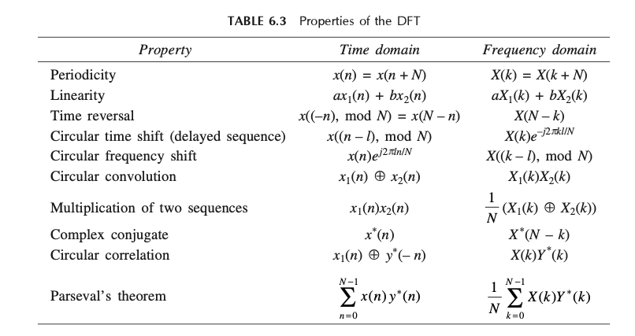

Slide 4
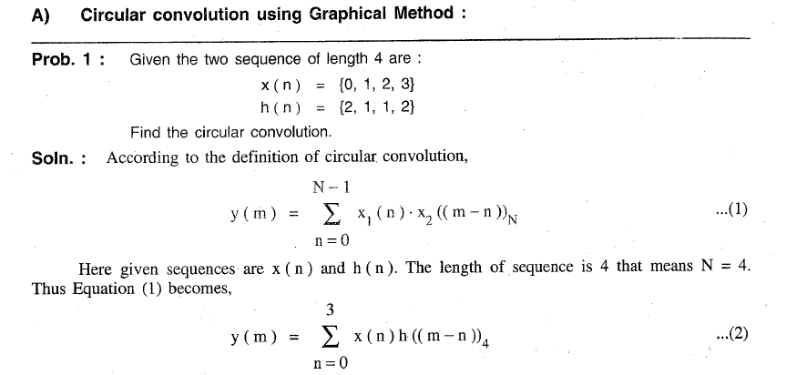

Slide 5
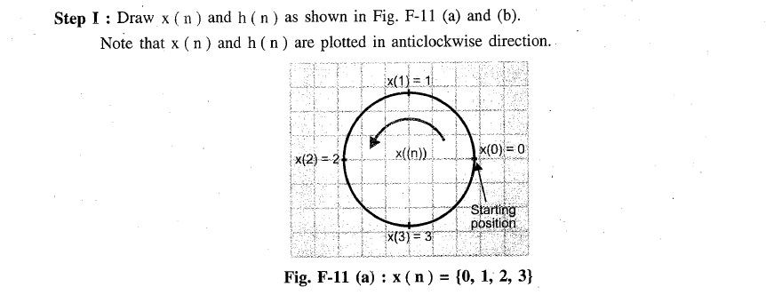

Slide 6
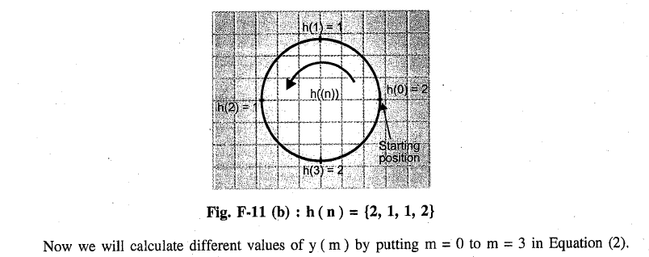

Slide 7


Slide 8
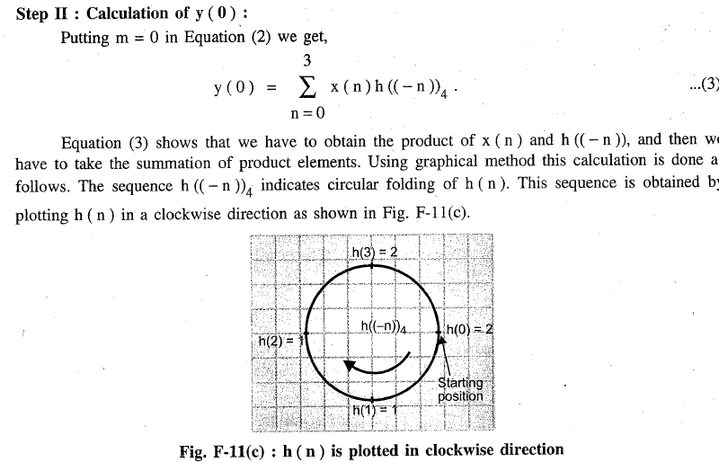

Slide 9
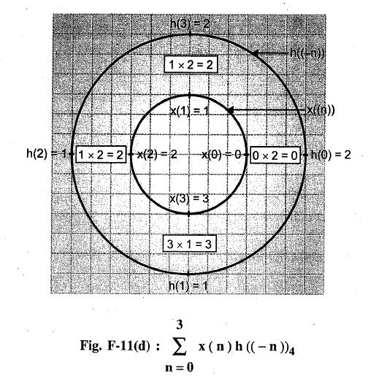
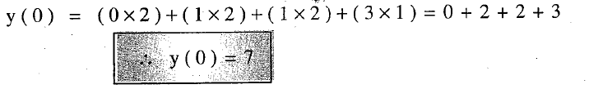

Slide 10
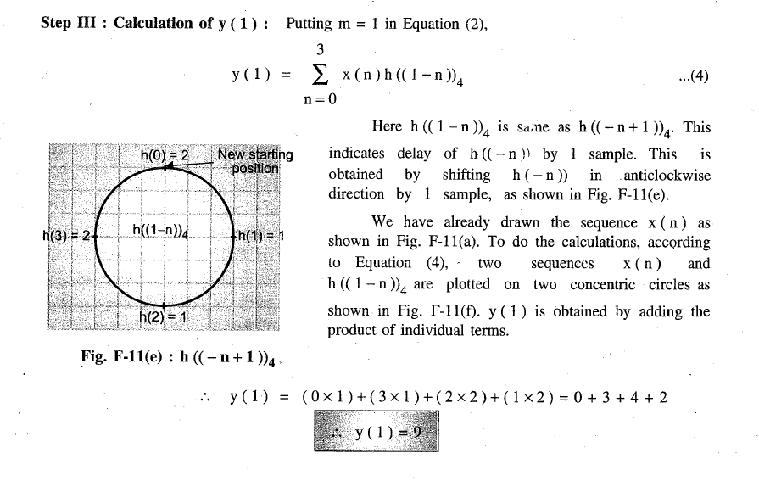

Slide 11
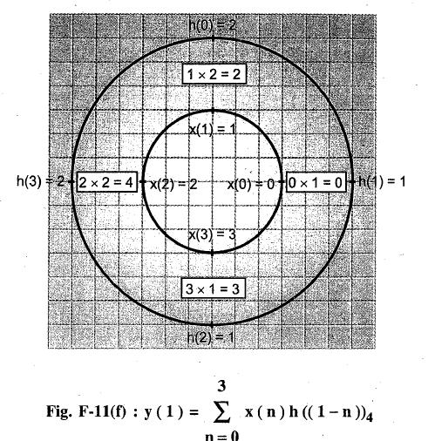

Slide 12
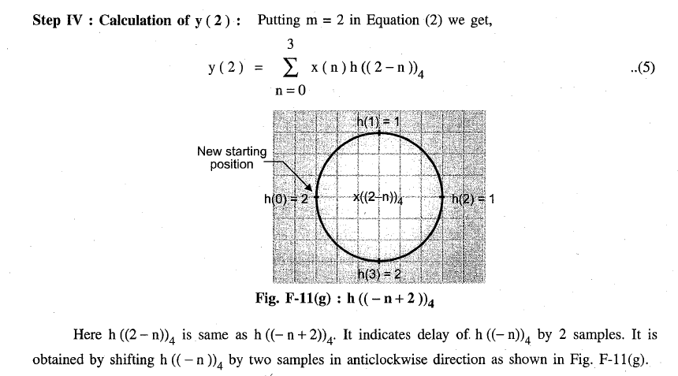

Slide 13
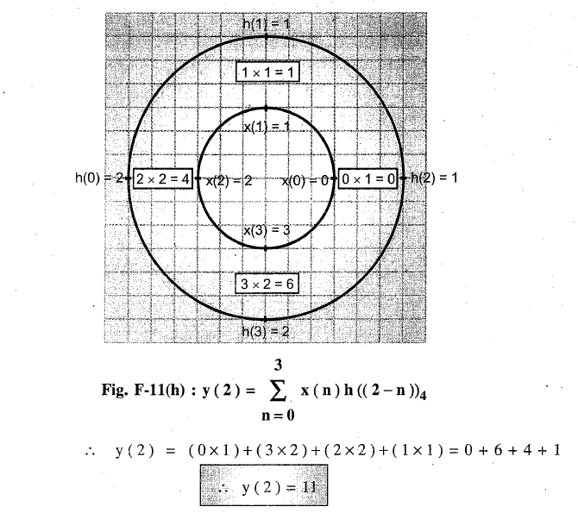

Slide 14
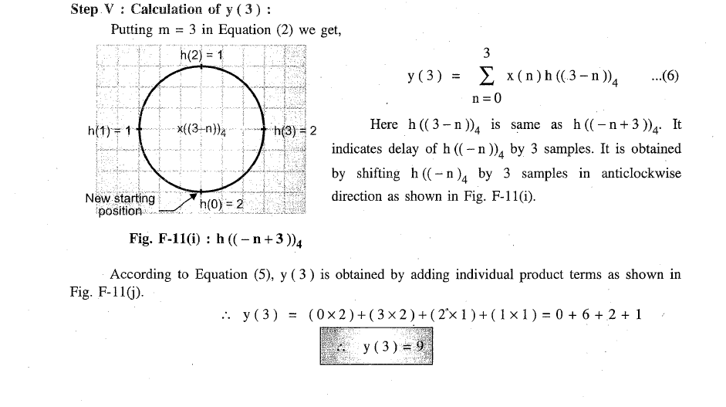

Slide 15
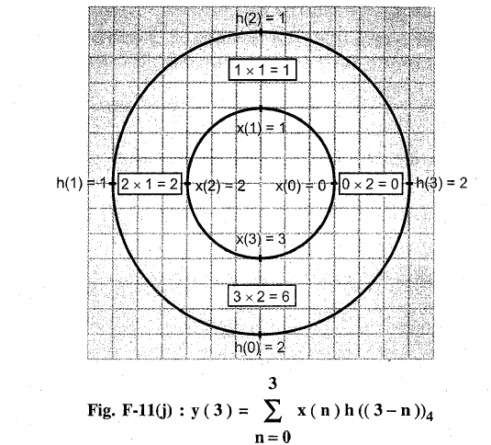

Slide 16
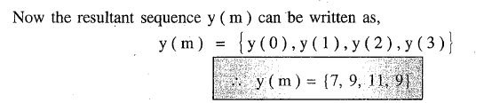

Slide 17
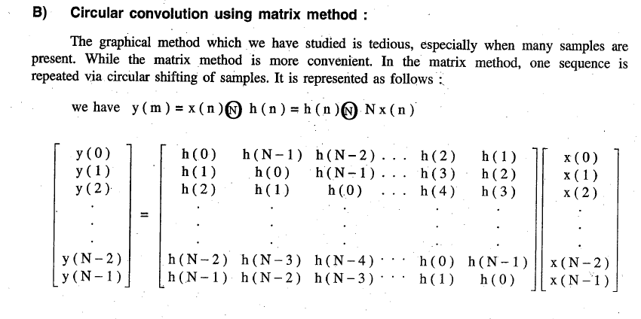

Slide 18
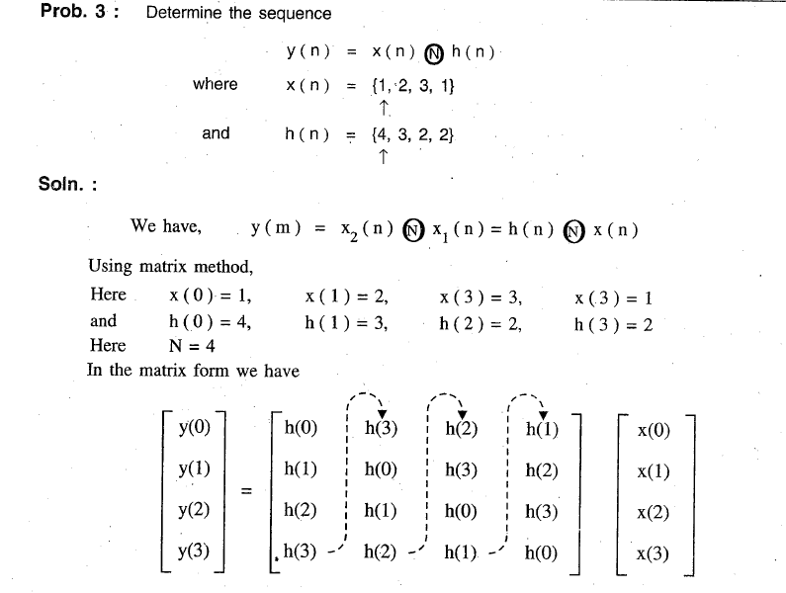

Slide 19
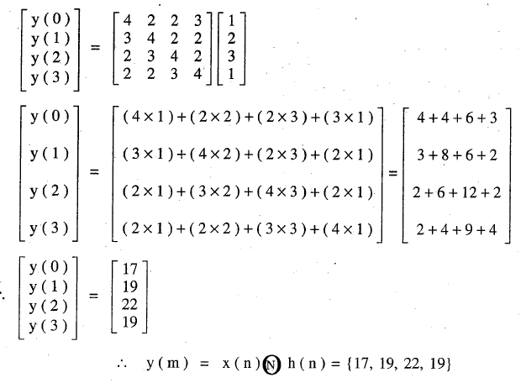

Slide 20
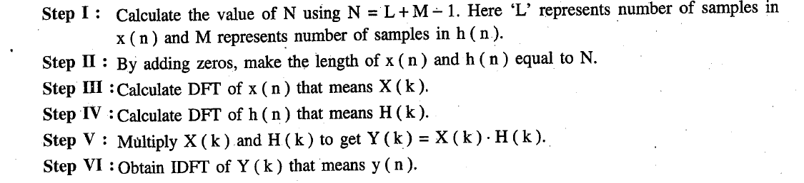
Linear Convolution using DFT and IDFT

Slide 21
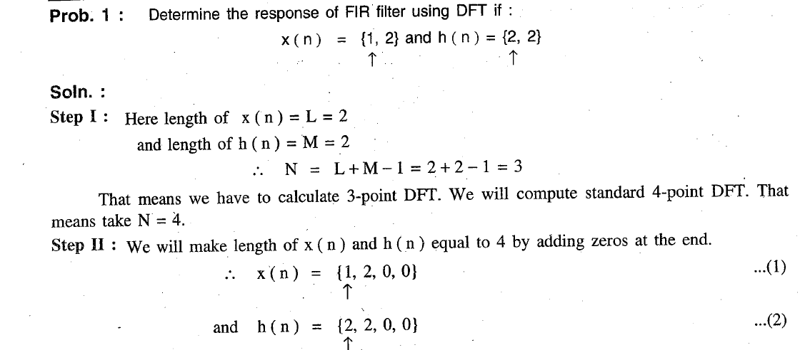

Slide 22
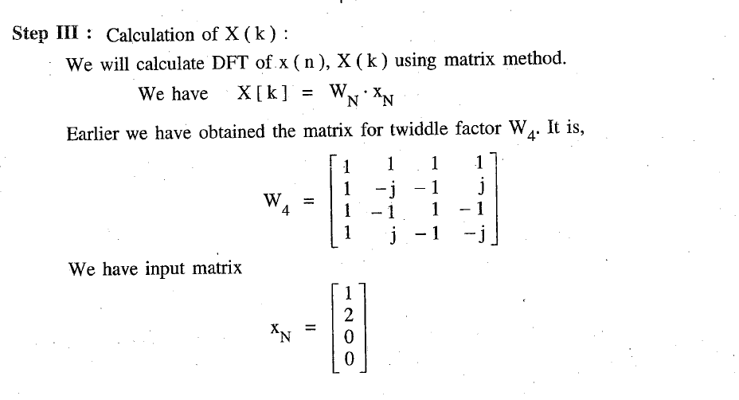

Slide 23
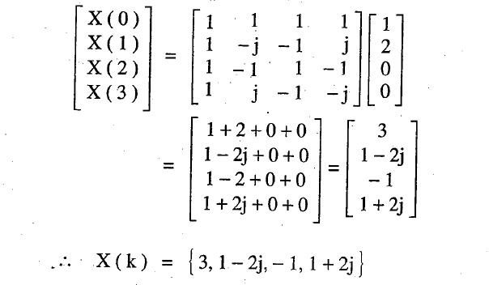

Slide 24
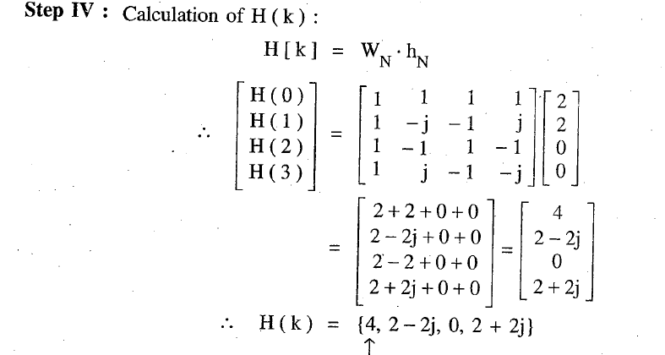

Slide 25
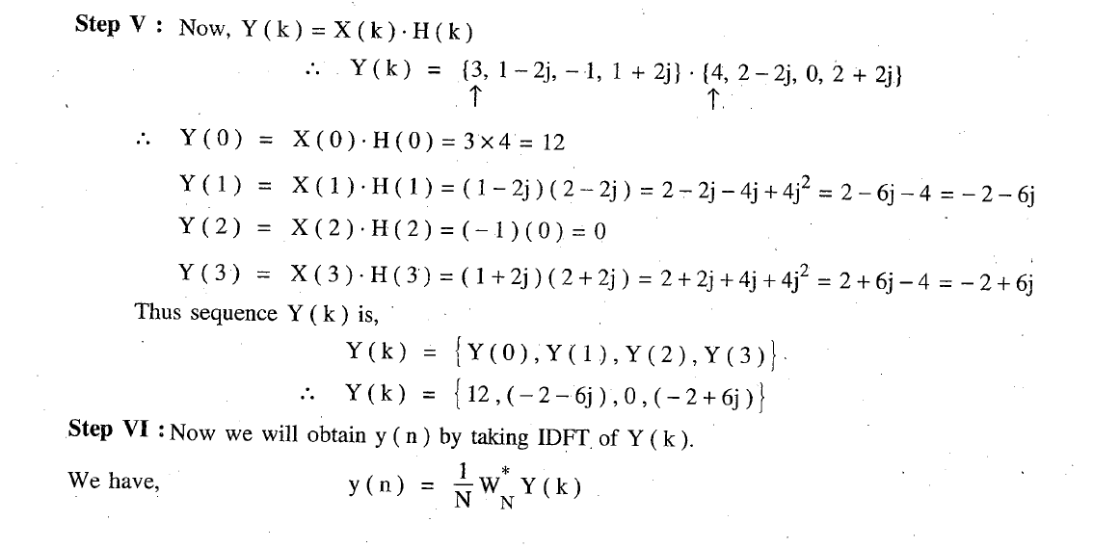

Slide 26
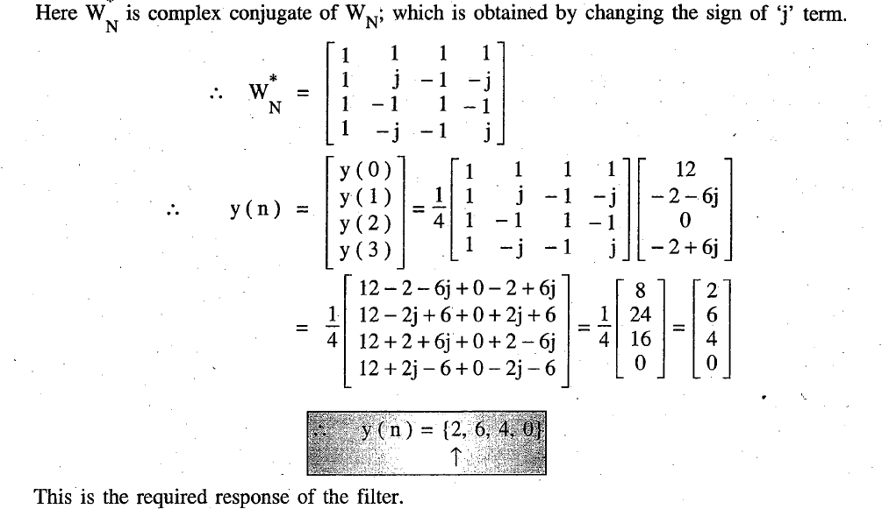

Slide 27
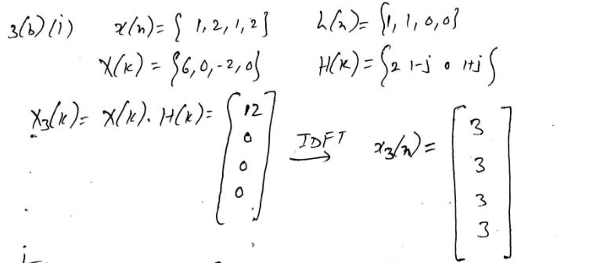
Circular Convolution using DFT and IDFT
Find the circular convolution of x(n)= (1,2,1,2) and h(n) = (1,1,0,0) using DFT.

Slide 28
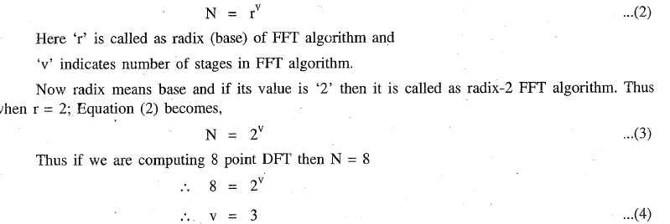
Radix-2 Fast Fourier Transform Algorithm

Slide 29
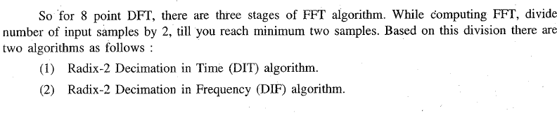

Slide 30
Properties of Twiddle Factor

Slide 31
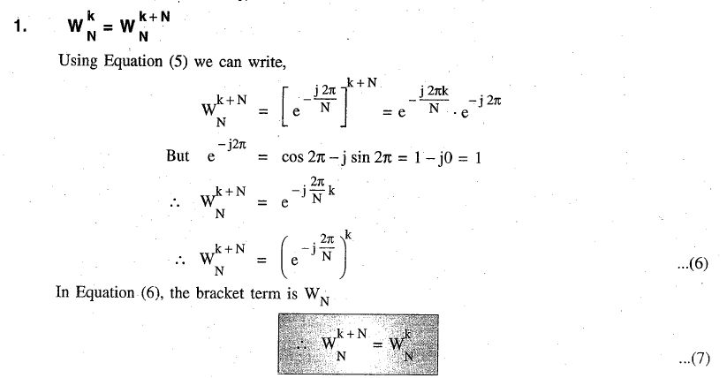

Slide 32
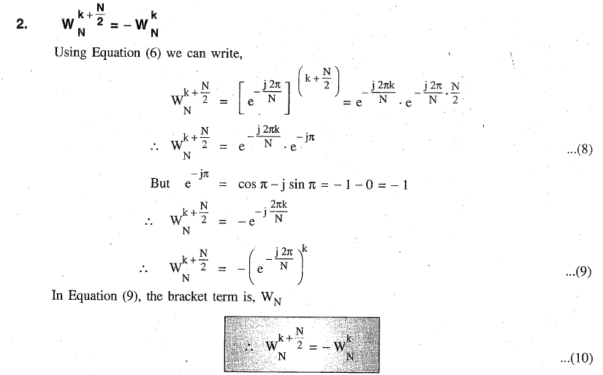

Slide 33
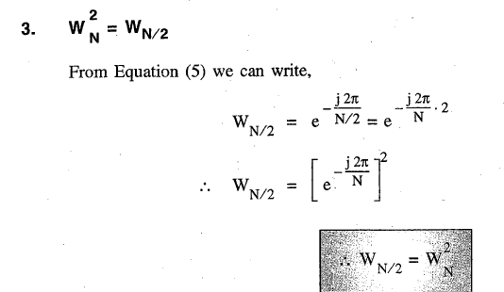

Slide 34
Radix-2 Decimation in Time (DIT) Algorithm

Slide 35
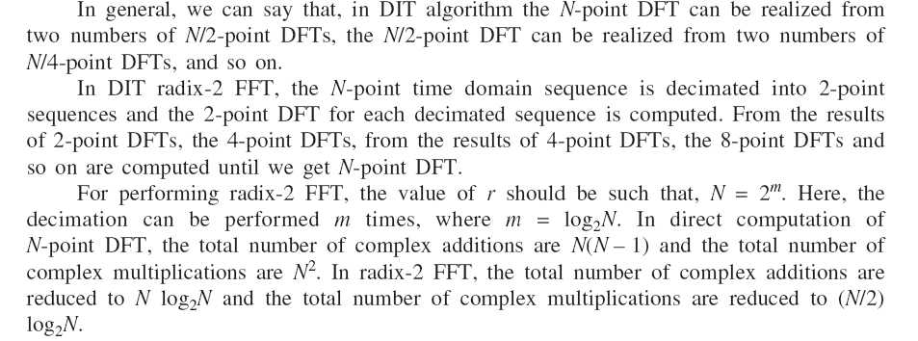

Slide 36
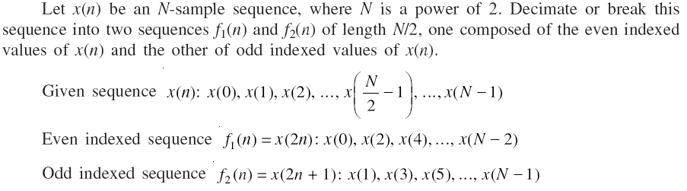

Slide 37
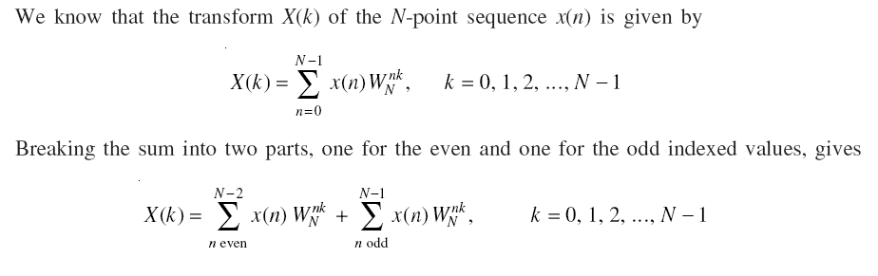

Slide 38
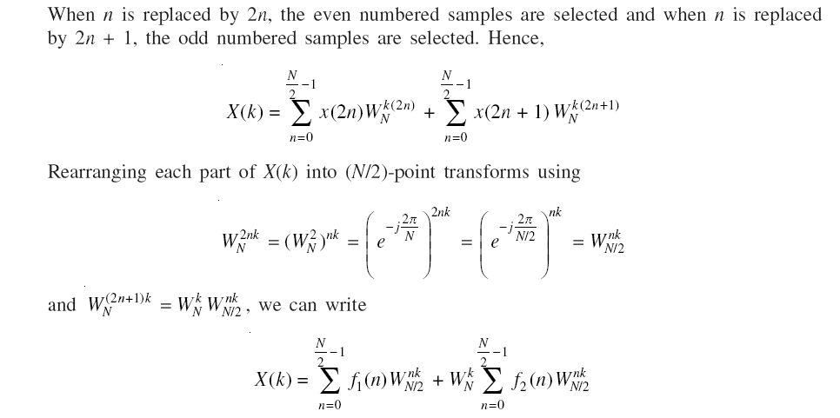

Slide 39
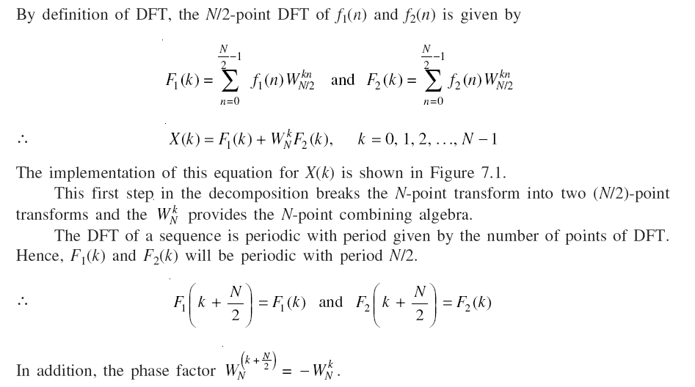

Slide 40
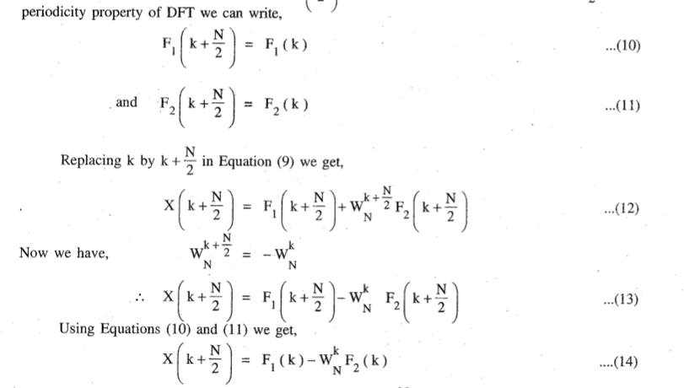

Slide 41
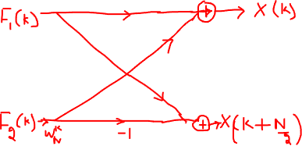
2 POINT DIT FFT

Slide 42
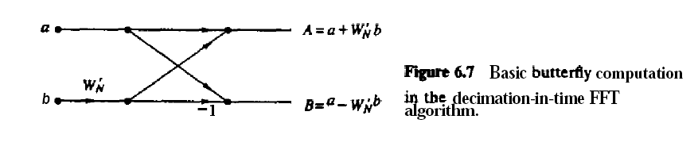
2 POINT DIT FFT

Slide 43
4 POINT DIT FFT

Slide 45
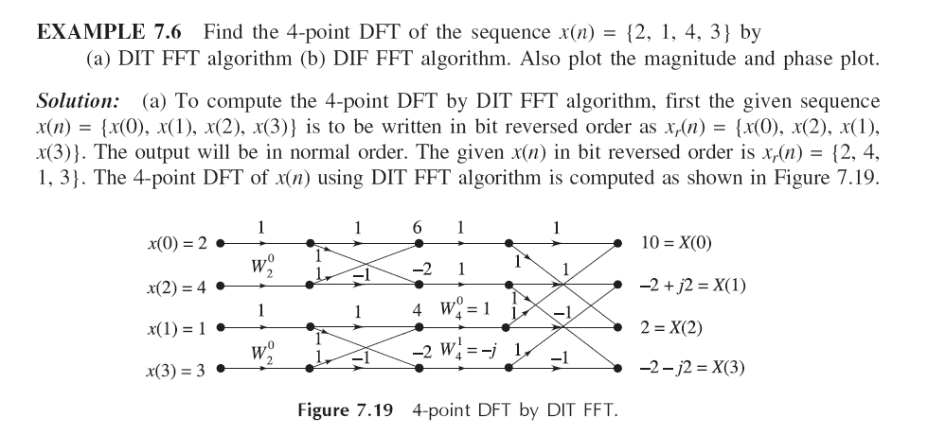

Slide 46
FFT may be used to calculate
1) DFT
2) IDFT
3) Direct Z transform
4) In direct Z transform
a. 1, 2 and 3 are correct
b. 1 and 2 are correct
c. 1 and 3 are correct
d. All the four are correct

Slide 47
B

Slide 48
8 POINT DIT FFT

Slide 49
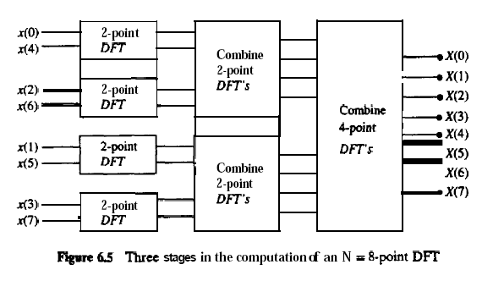

Slide 50
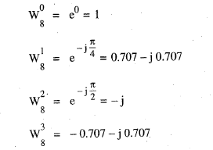

Slide 51
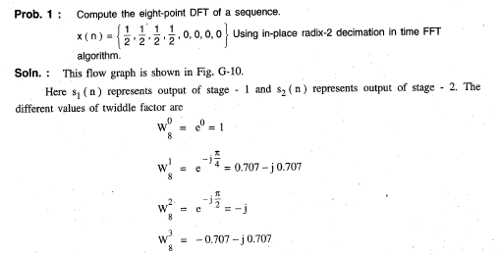

Slide 52
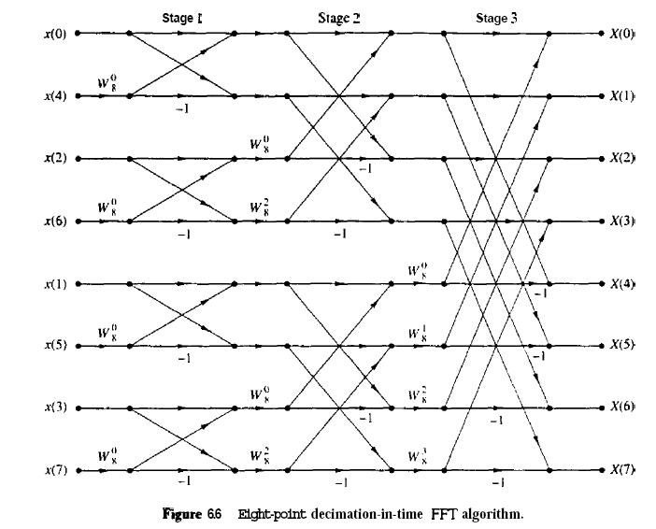

Slide 54
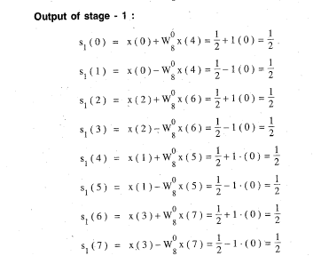

Slide 55
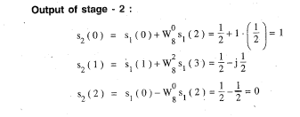
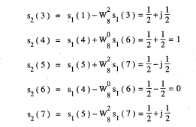

Slide 56
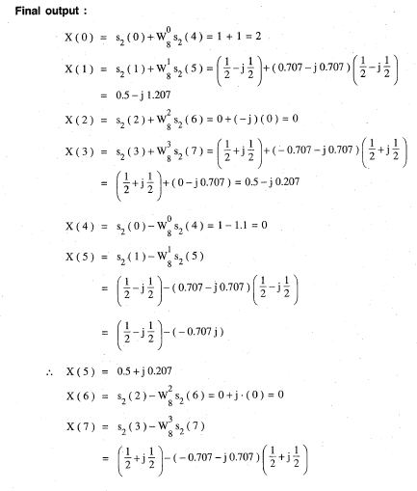


Slide 57
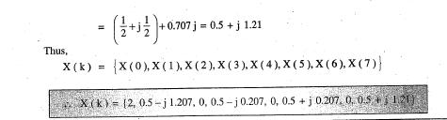

Slide 58
DIT algorithm divides the sequence into
a. Positive and negative values
b. Even and odd samples
c. Upper higher and lower spectrum
d. Small and large samples

Slide 59
B

Slide 60
Radix-2 Decimation in Frequency (DIF) Algorithm

Slide 61
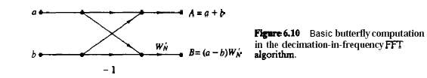
2 POINT DIF FFT

Slide 62
4 POINT DIF FFT

Slide 63
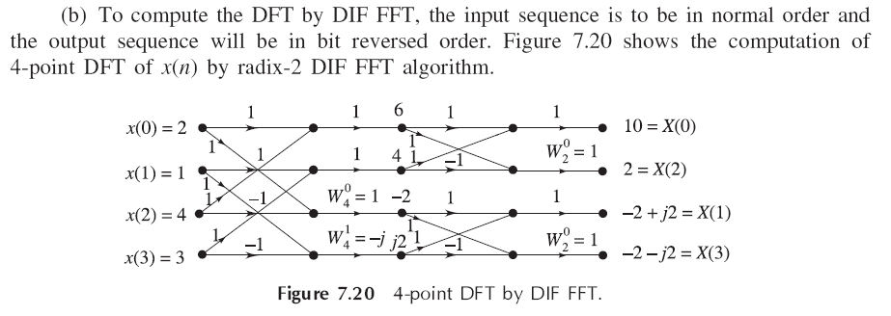


Slide 64
8 POINT DIF FFT

Slide 65


Slide 66


Slide 67


Slide 68


Slide 69


Slide 70


Slide 71


Slide 72


Slide 73


Slide 74


Slide 75
DFT is applied to
a.Infinite sequences
b. Finite discrete sequences
c. Continuous infinite signals
d. Continuous finite sequences

Slide 76
b

Slide 77
If x(n) is a real sequence and X(k) is its N-point DFT, then which of the following is true?
a) X(N-k)=X(-k)
b) X(N-k)=X*(k)
c) X(-k)=X*(k)
d) All of the mentioned

Slide 78
d

Slide 79
Radix - 2 FFT algorithm performs the computation of DFT in
a. N/2Log2 N multiplications and 2Log2 N additions
b. N/2Log2 N multiplications and NLog2 N additions
c. Log2 N multiplications and N/2Log2 N additions
d. NLog2 N multiplications and N/2Log2 N additions

Slide 80


Slide 81
W_{N}^{k+N/2}=?
a) W_{N}^{k}
b) -W_{N}^{k}
c) W_{N}^{-k}
d) None of the mentioned

Slide 82
B

Slide 83
Determine the number of complex multiplications for the 8-point Radix-2 FFT.
32
12
80
4

Slide 84
B

